Slide 1
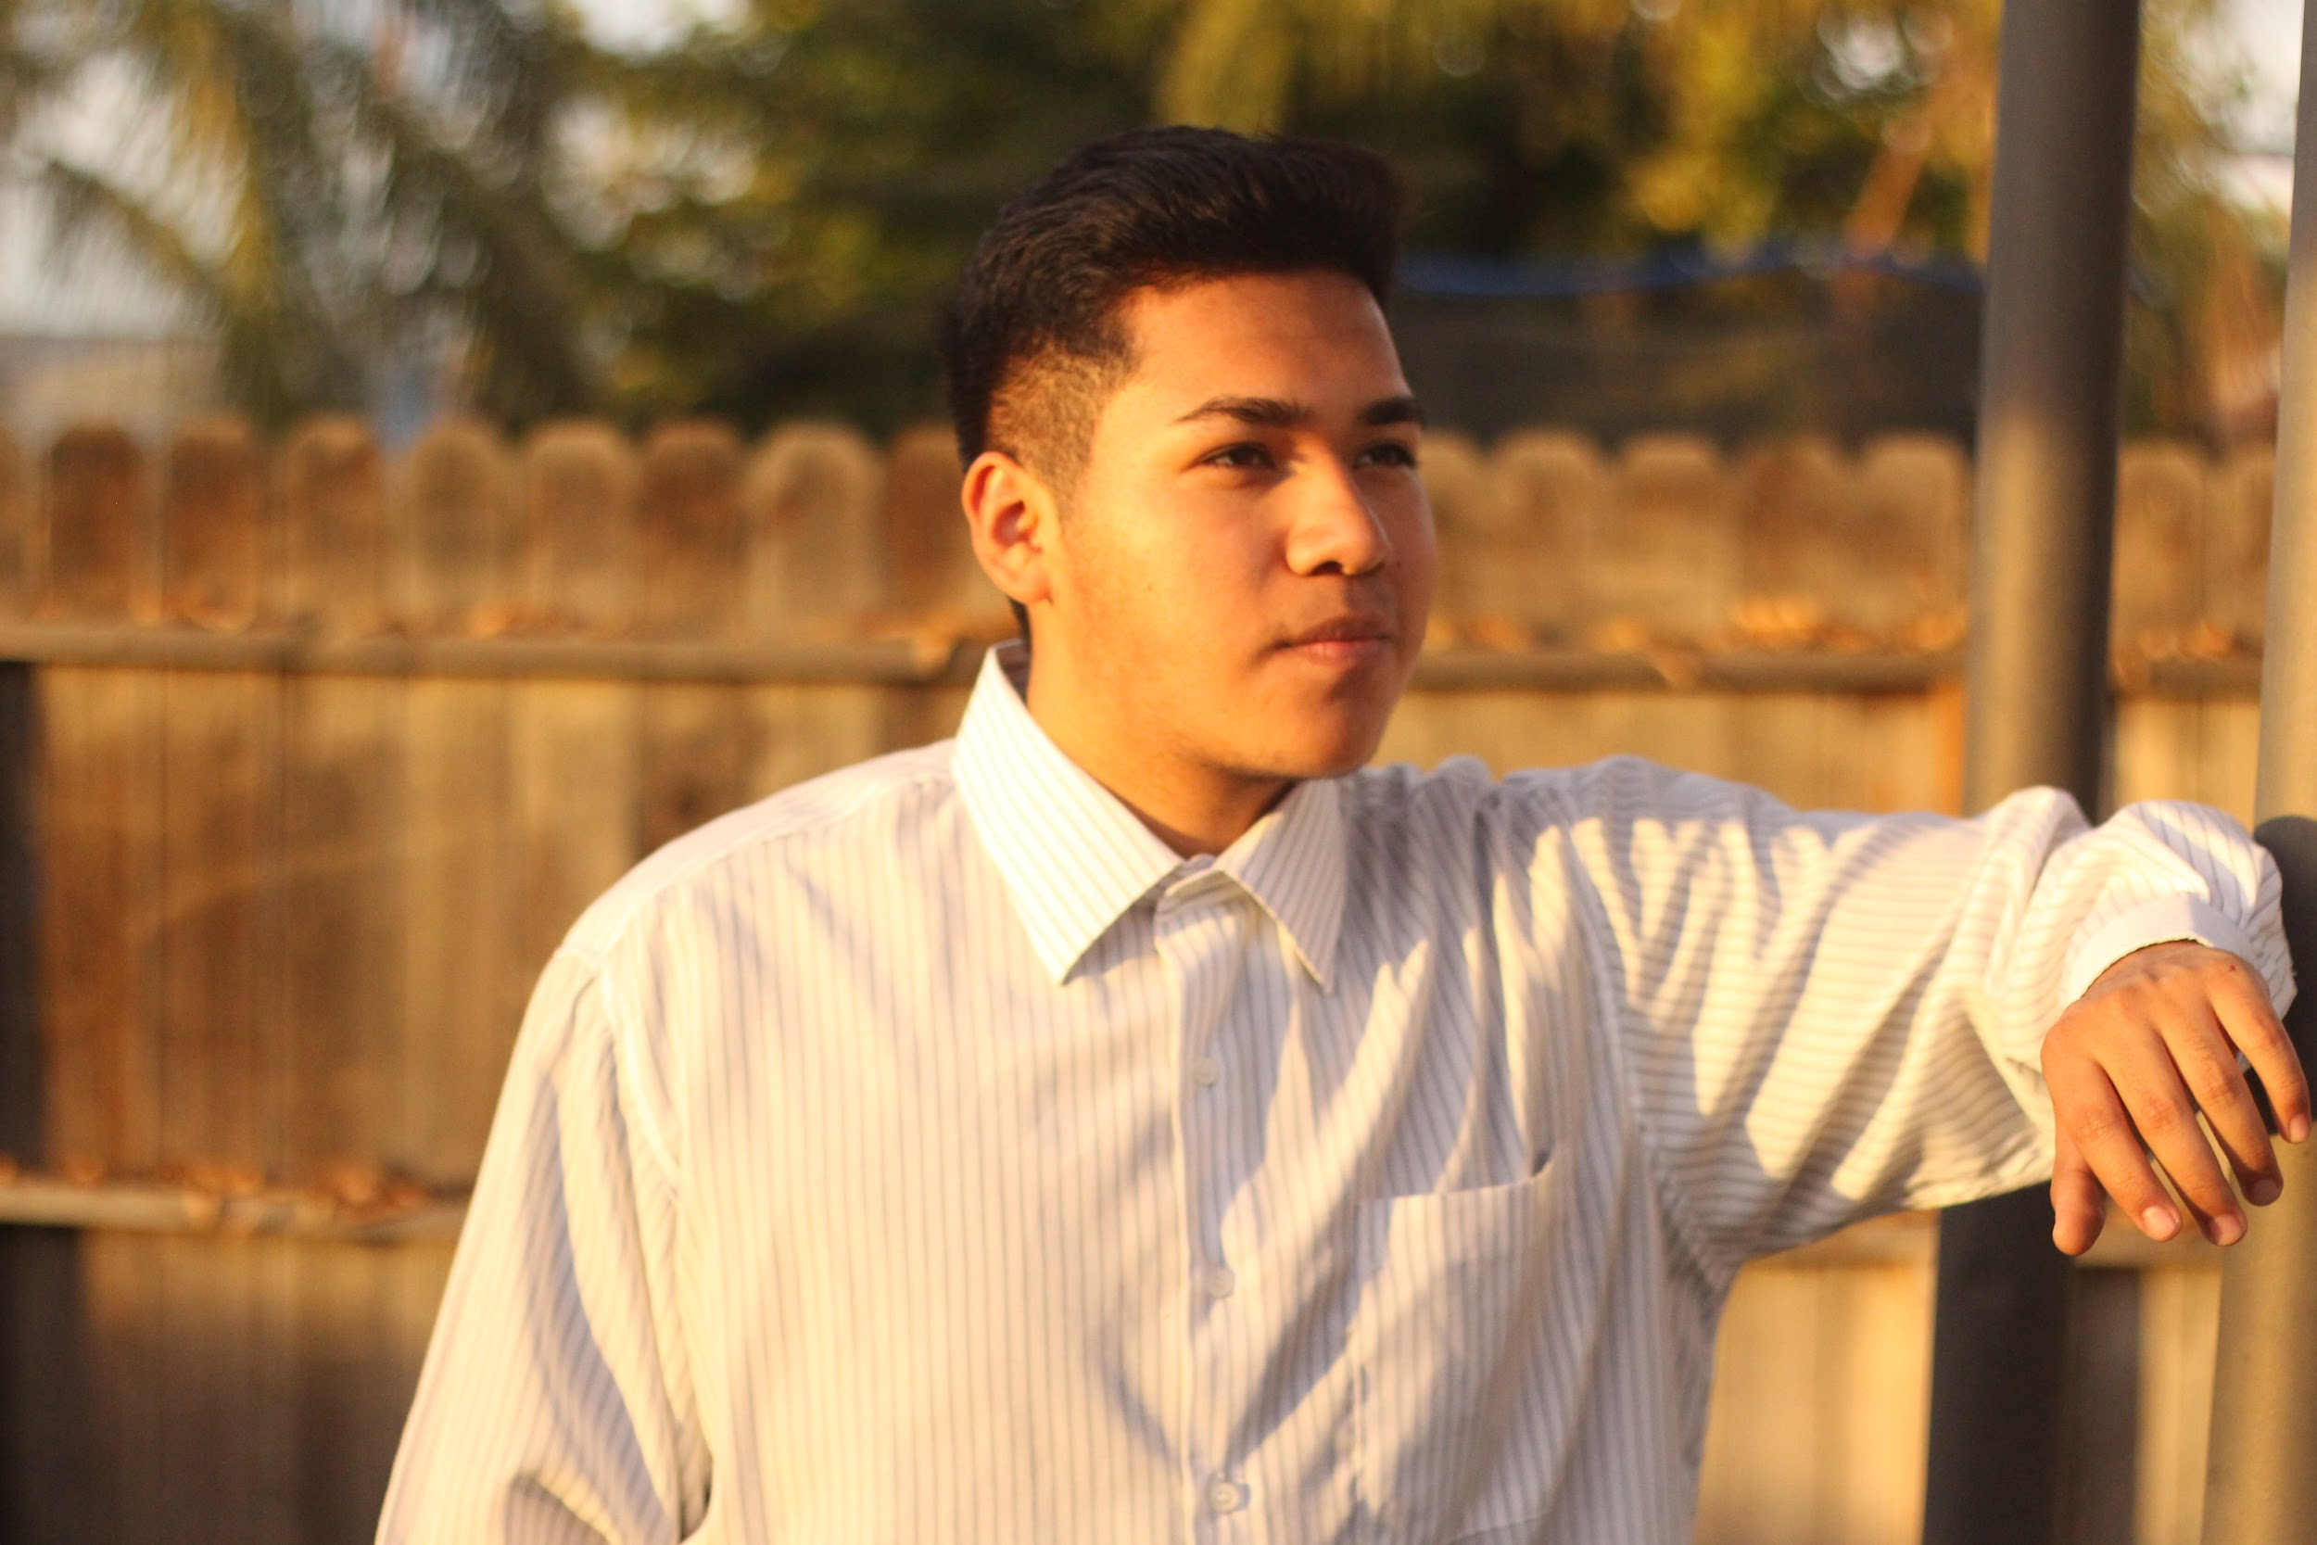
Jose Ventura Munoz-Bernabe

Slide 2
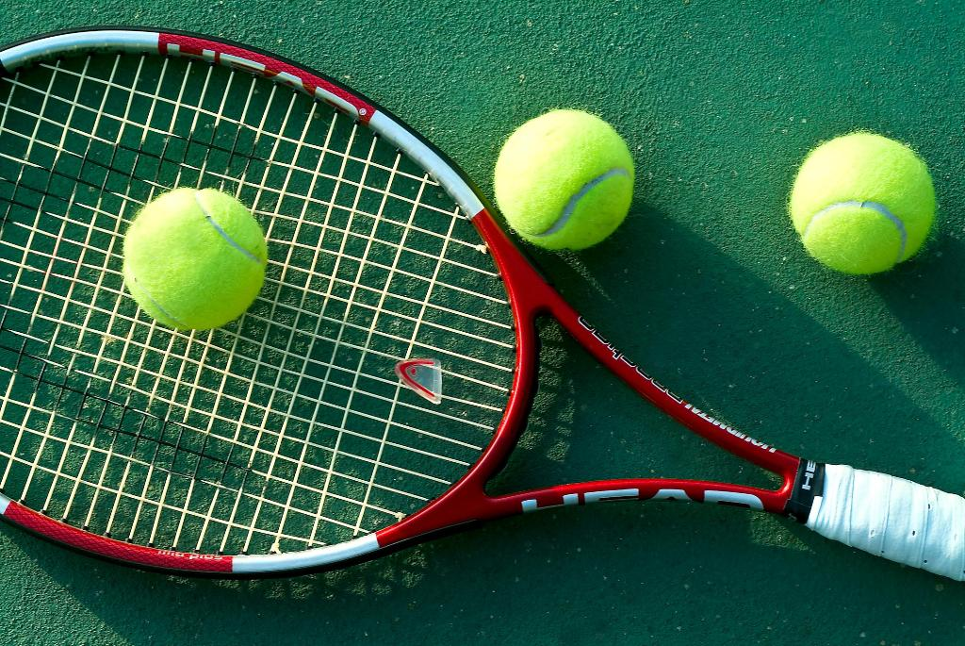
Me, Myself, and I
Born in Porterville, california.
The youngest of 4
Enjoy playing soccer and tennis
Life motto: When life gives you lemons, be sure to pay for them.

Slide 3
School Experience
Learned extensive welding techniques, basic woodworking, automotive knowledge.
Clubs: Guitar club, Gaming club, Anime club, and FFA

Slide 4
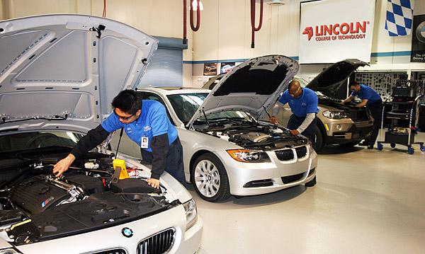
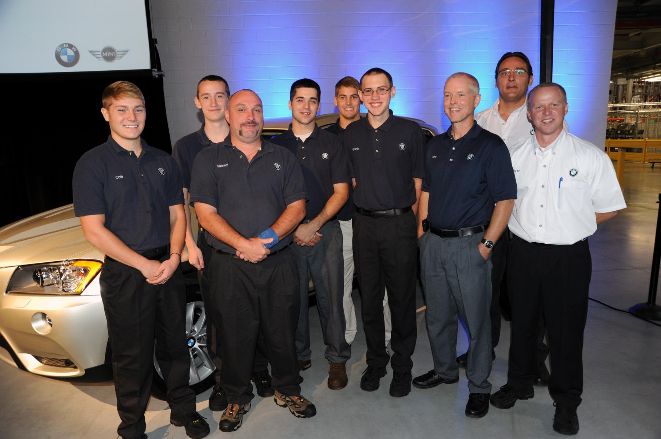
Pathway
Automotive

Slide 5
Post-High School Plans

Slide 6
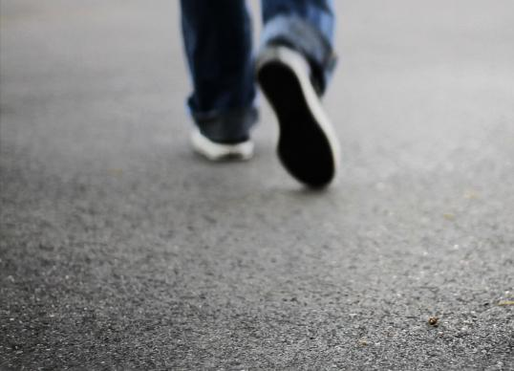
Leaving LHS
Helped me learn how to work hard and move ahead
Challenges:
Getting interested
Learning not to give up

Slide 7
Questions or
Coments?

